Slide 1

Building Modern Approvals
Advanced Concepts

Slide 2







Paul Papanek Stork
Owner/Principal Architect
Don’t Pa..Panic Consulting
Author
Available Now!
Power Platform Community Contributor
    Super User in…
    Power Apps
    Power Automate
    Power Virtual Agent
Contact Information
Email:
pstork@dontpapanic.com
Blog:
dontPaPanic.com/blog
Twitter:
@PStork
Don’t Pa..Panic Consulting

Slide 3








Please thank our sponsors

Slide 4
Agenda
Applying custom formatting to the approval email
Recording approval results and comment
Forwarding an approval if the approver is out of the office
Escalating an approval that hasn’t been responded to
Sending periodic reminders about pending approval
Building an approval for a dynamic list of approvers
Creating an approval that will run for more than 30 days

Slide 5
Review: Basic Approval Types
Start and Wait for an Approval of Text
Create an Approval / Wait for an Approval
Start and Wait for An Approval
  Approval Types
    Everyone must Approve
    First to Respond
    Custom Responses (Wait for One or All)
New Type – Sequential Approval

Slide 6
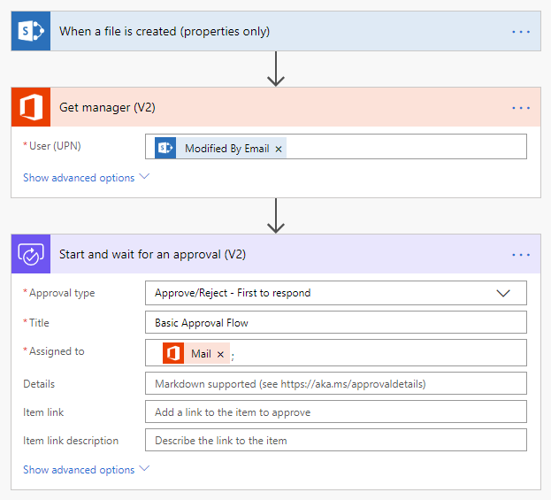
Review: Basic Approval Flow
Starting Point for Today’s demos
  Item or File created in SharePoint
  Get Manager using Modified By property
  Start and wait for an approval (V2)
Notes:
  Using Modified By = Created By in new record

Slide 7
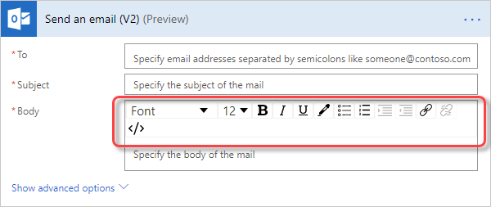
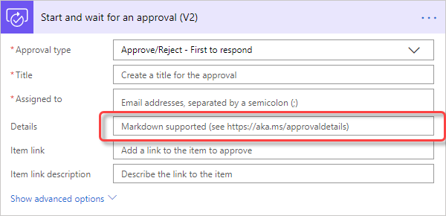
#1 - Applying custom formatting
Problem: How to format approval email?
  No WYSIWYG editor
  Can’t embed HTML codes
Solution:
  Markdown codes are available at https://aka.ms/approvaldetails
Ongoing Issue:
  Formatting is not consistent across different browsers and clients
Notes:
00 Basic Approval
01_CustomEmailMarkup

Slide 8
Support for Approval Markdown
Feature | Power Automate | Power Automate mobile app | Outlook Desktop | Outlook Web | Teams | Teams mobile app | Teams Approvals App
Headers | Yes | Yes | Yes | Yes | No | No | No
Numbered Lists | Yes | Yes | No | Yes | Yes | Yes | No
Nested Numbered Lists | Yes | Yes | No | Yes | Yes | Yes | No
Tables | Yes | Yes | Yes | Yes | No | No | No
Images | No | No | No | No | No | No | No
Forced Line Breaks | Yes* | Yes* | No (use a blank line instead) | Yes* | Yes* | Yes* | No
Blank Lines | No | No | Yes | Yes | No | Yes | No
Emphasis | Yes | Yes | Yes | Yes | No | No | No
Links | Yes | Yes | Yes | Yes | Yes | Yes | Yes
* Not supported within table cells
Notes:
*Forced line breaks within table cells are not supported for Power Automate, the Power Automate mobile app, Outlook Web, Teams, and the Teams mobile app.

Slide 9
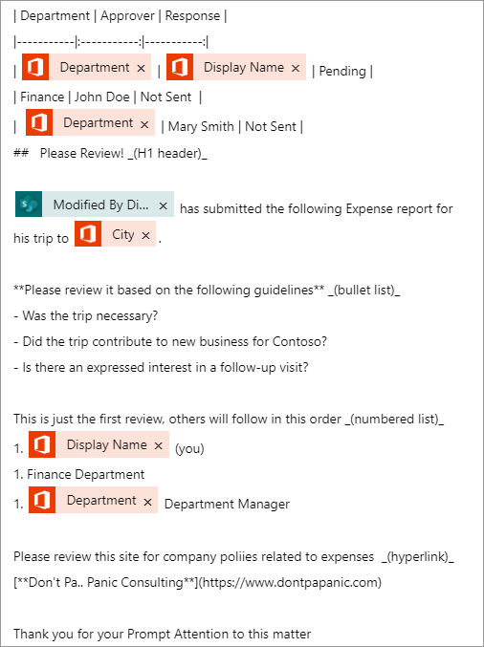
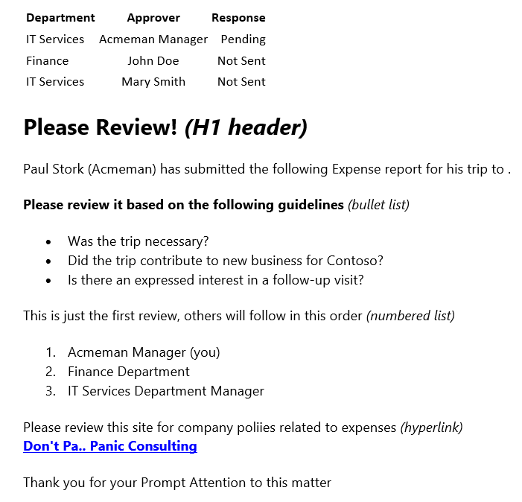
Custom Formatting Example
Notes:
01_CustomEmailMarkup

Slide 10
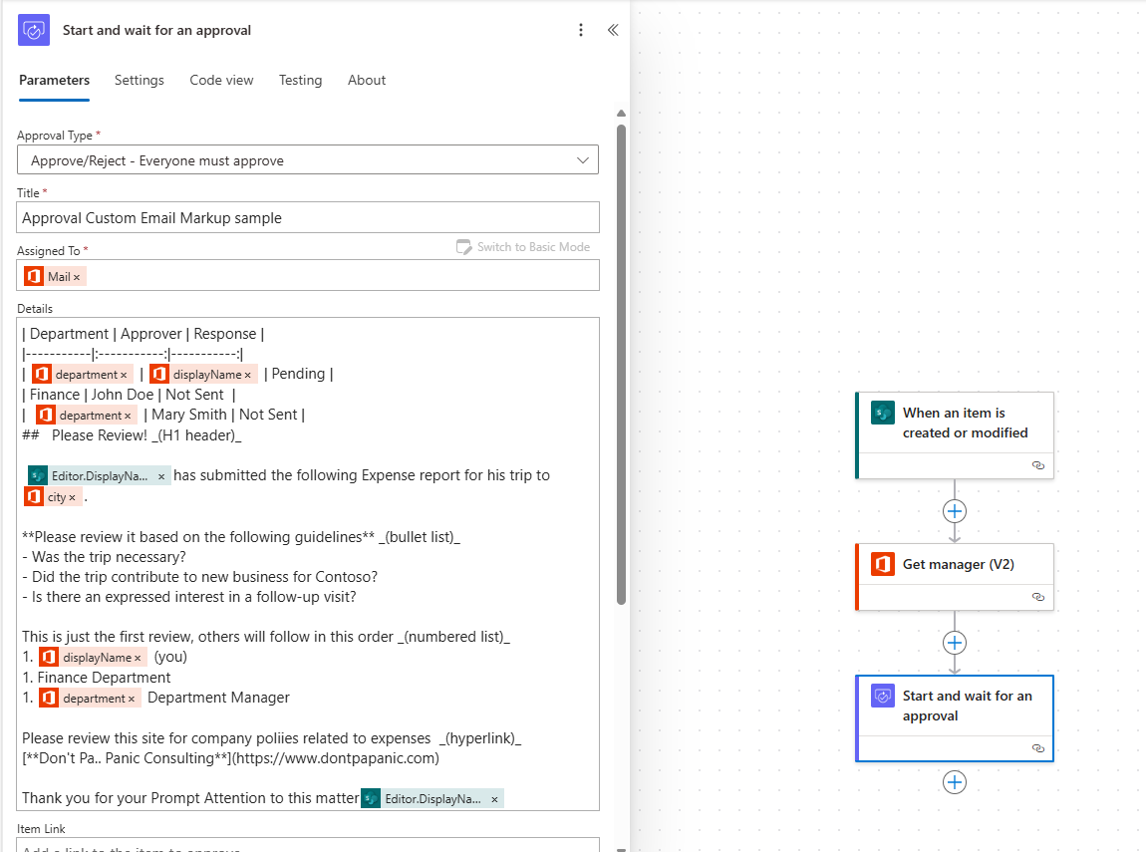

Slide 11
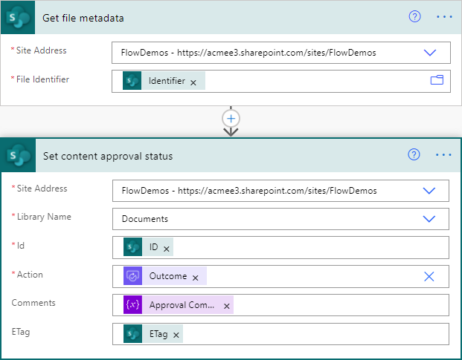
#2 - Recording Approval Results/Comments
Problem: Approval Status and Comments
  Stored in History Tab – Not easily accessible
  Only available to Flow Maker
Solution:
  Update SharePoint metadata
  Aggregate Comments in a Loop
  Option - Built-in Content Approval columns
Ongoing Issue:
  Requires changes to SharePoint List/Library
  Can cause an Infinite Loop
Notes:
02_ApprovalComments

Slide 12
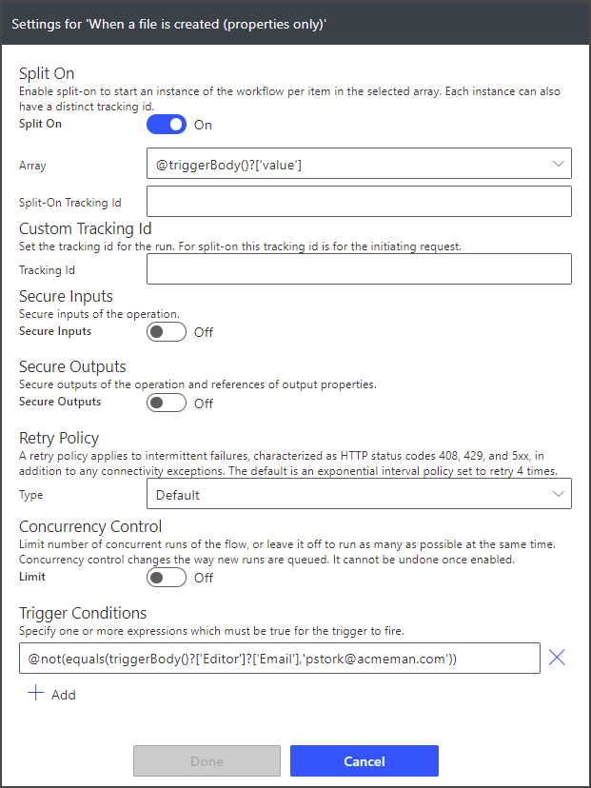
Prevent an Infinite Update Loop
Problem: Update Causes Infinite Loop
  SharePoint Update after Approval Re-Triggers the Flow Causing Infinite Loop
Solution:
  Use a Trigger Condition to prevent Loop
    Ignore Updates by Flow Maker/Service Account
    Ignore Updates based on Status
  Easily Create with Filter Array Action
Notes:
03_TriggerCondition
Trigger Condition - @not(equals(triggerBody()?['Editor']?['Email'],'pstork@acmeman.com’))
@not(equals(triggerBody()?['{ModerationStatus}'],'Approved'))

Slide 13
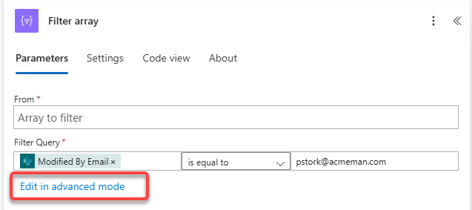
Only Fill in the Query, not the From
Then Copy the Advanced Mode Text

Slide 14
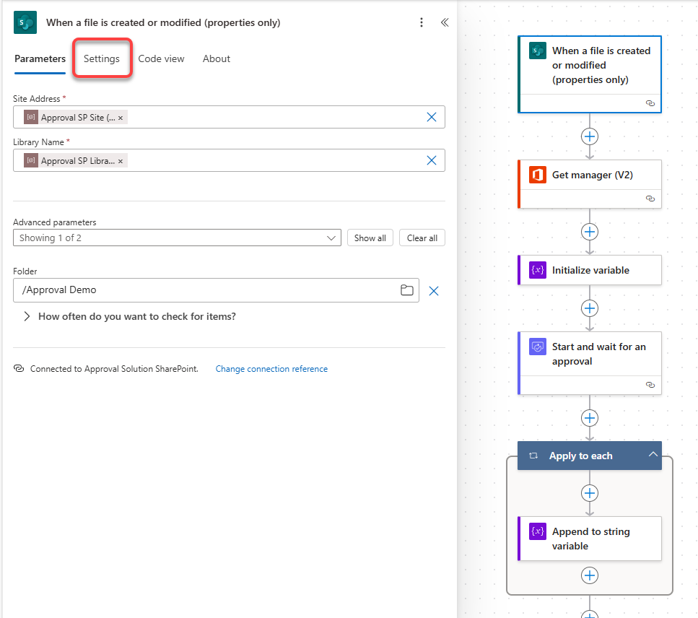
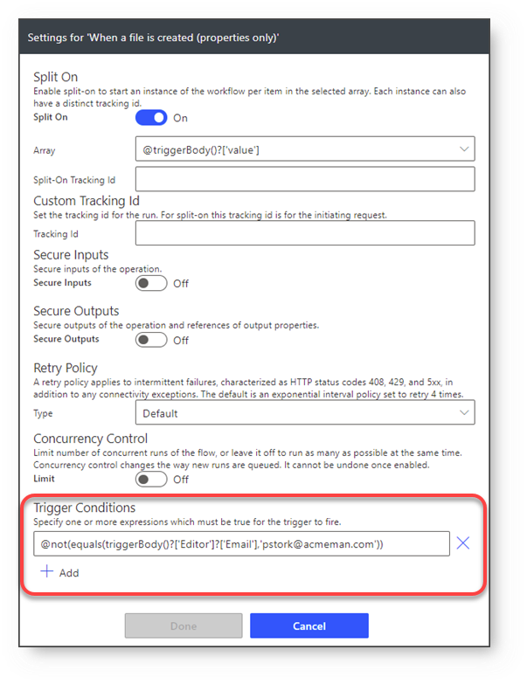

Slide 15
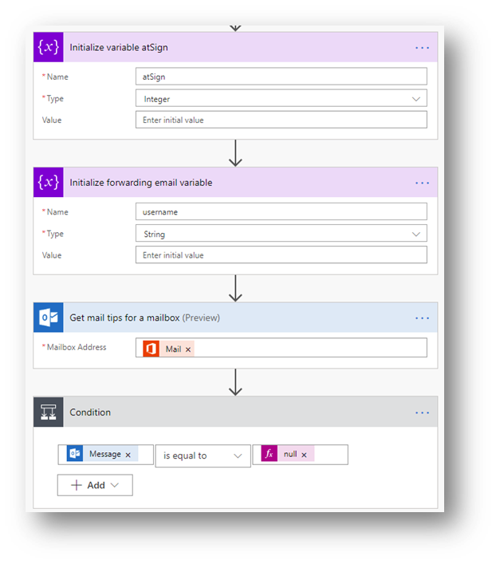
#3 - Forwarding an Approval
Problem: “Out of Office” approvers delay responses
  Discover that approver is out
  Forward Approval to alternate contact
Solution:
  Check OOO message using Get mail tips action
  Parse alternate approver from OOO message
Ongoing Issue:
  Error check for missing or multiple alternate approvers
Notes:
Domain first(split(last(split(body('Html_to_text'),'@')),' '))
last(split(replace(first(split(body('Html_to_text'),'@')),decodeUriComponent('%0A'),' '),' '))

Slide 16
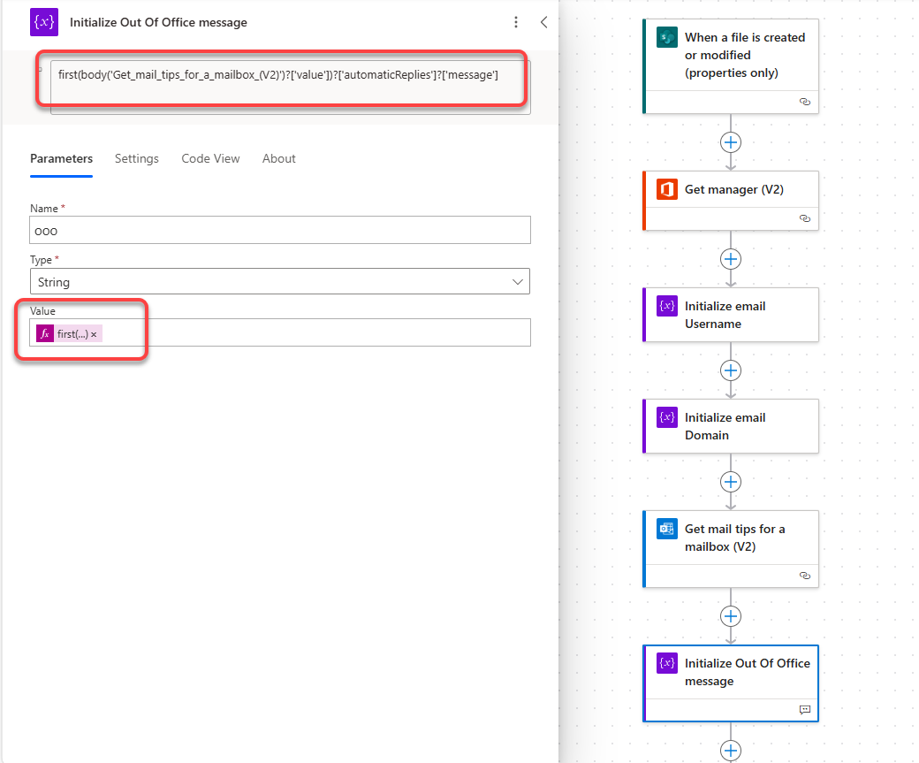

Slide 17
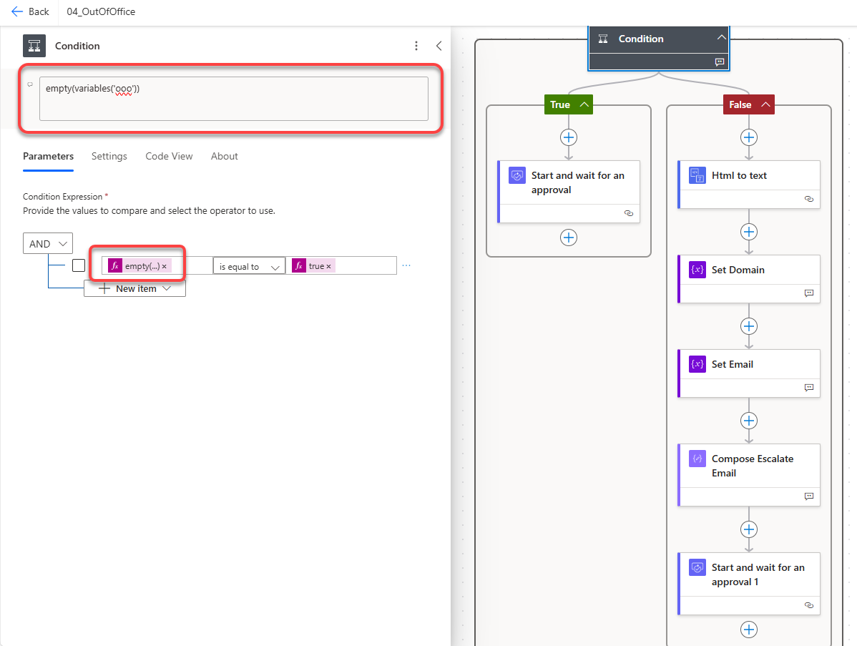

Slide 18
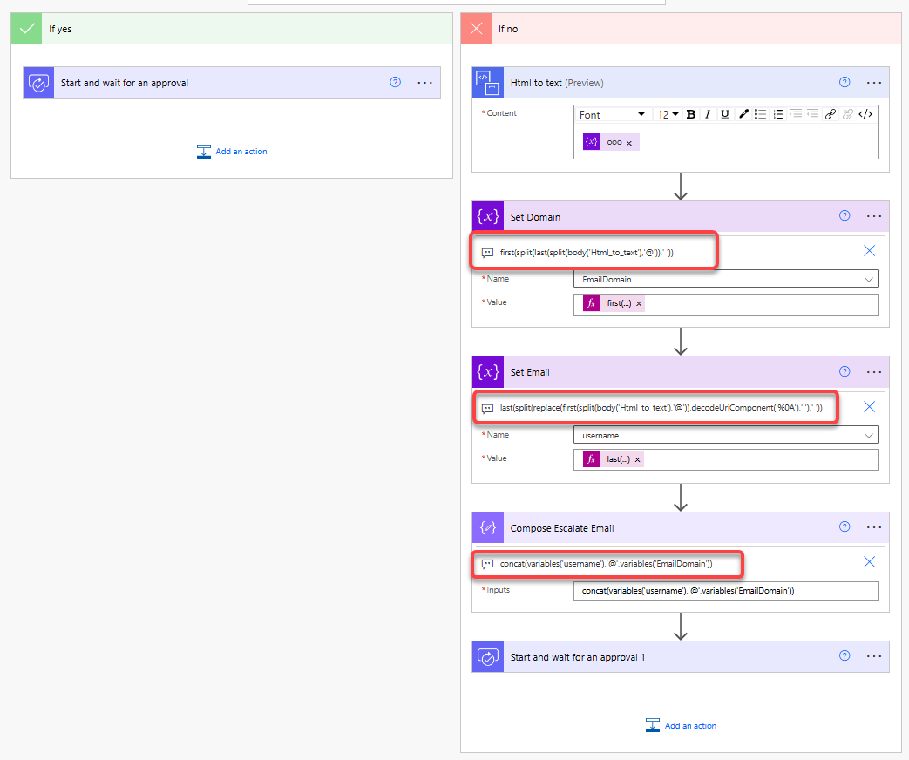
first(split(last(split(body('Html_to_text’),'@')),' '))
last(split(replace(first(split(body('Html_to_text'),'@’)),
decodeUriComponent('%0A'),' '),' ‘))
concat(variables('username'),'@',variables('EmailDomain’))

Slide 19
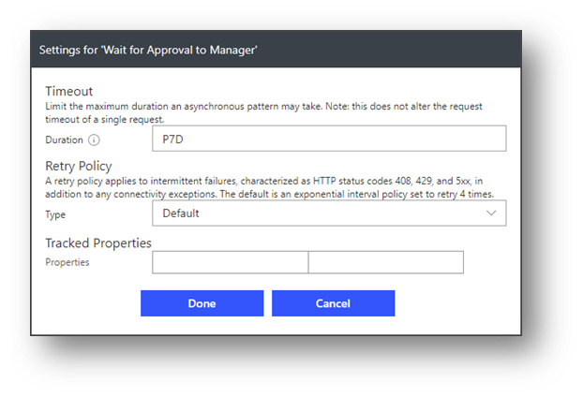
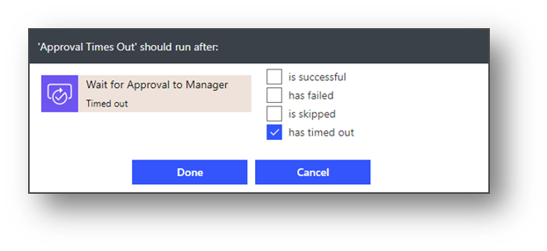
#4 - Escalating an Approval
Problem: Approver may not respond with time limit
  Need to resend approval if time limit exceeded
  Need to clean up old approval
Solution:
  Use a parallel branch to send another approval if the first times out
  Delete the original approval record in CDS
Ongoing Issue:
  Dataverse cleanup requires premium license

Slide 20
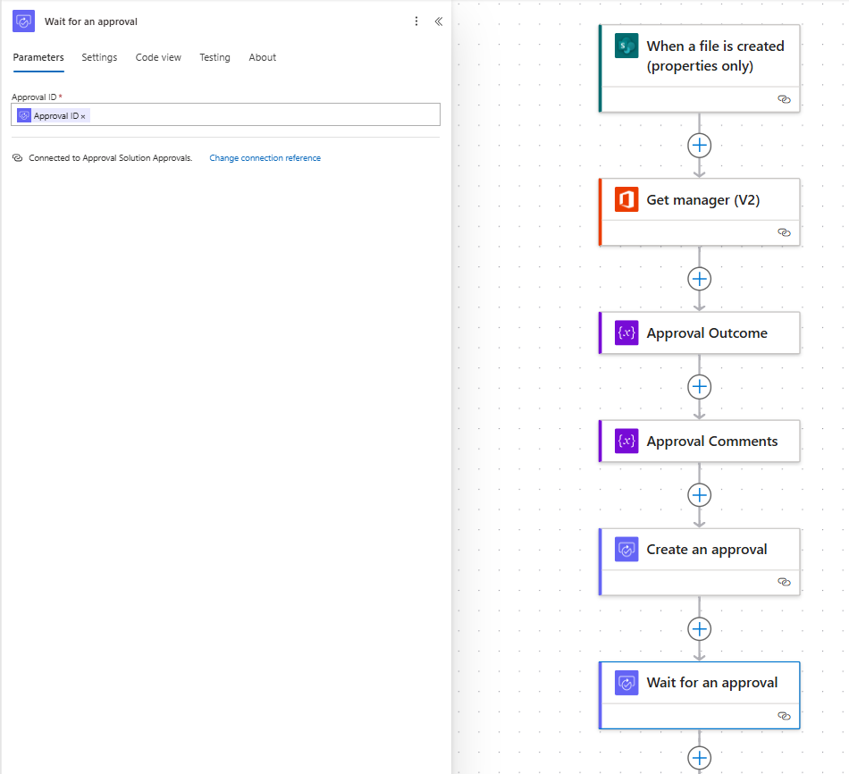
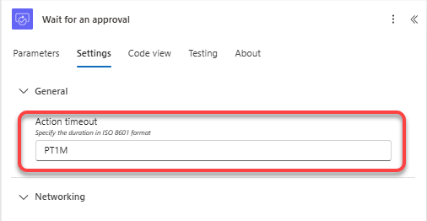
Set Timeout using ISO 8601 Duration
‘P’ – Period
‘xD’ – Days
‘T’ – Time
‘xHxMxS’ – Hours/Minutes/Seconds

Slide 21
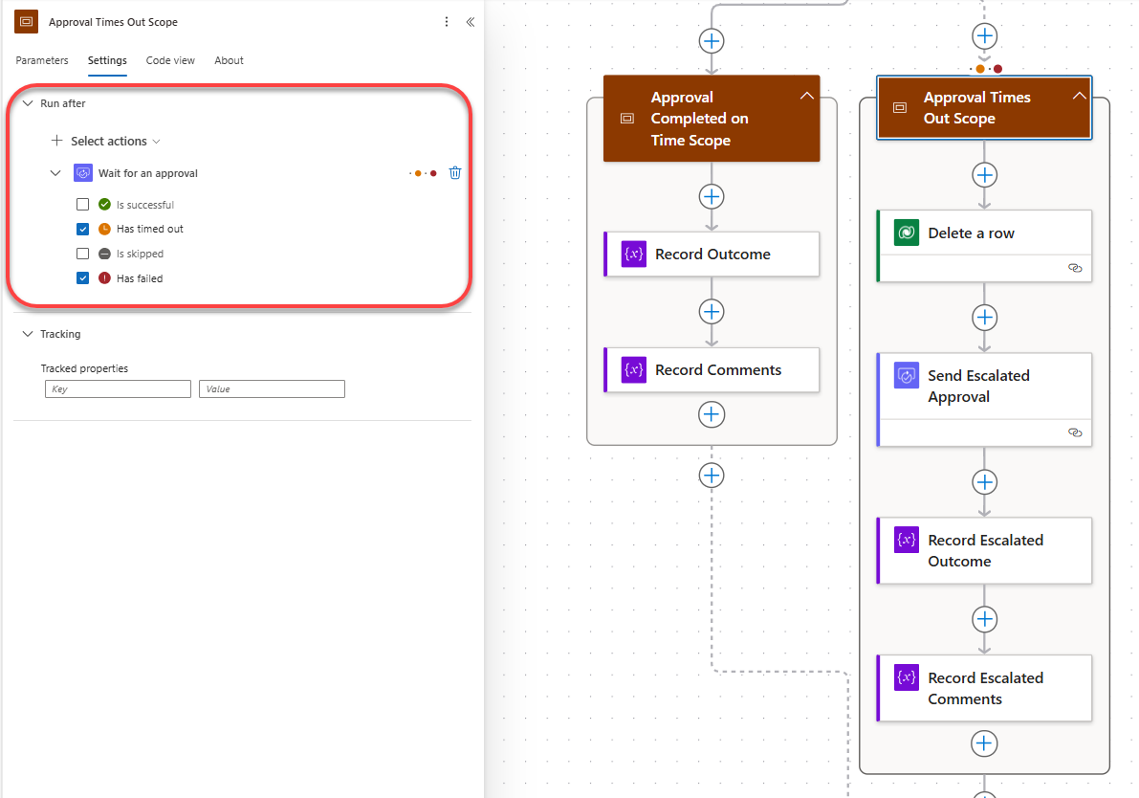
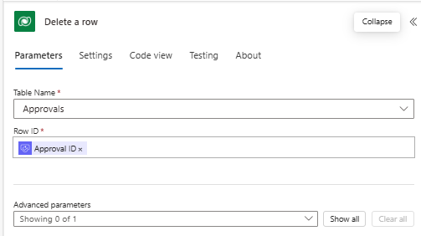

Slide 22
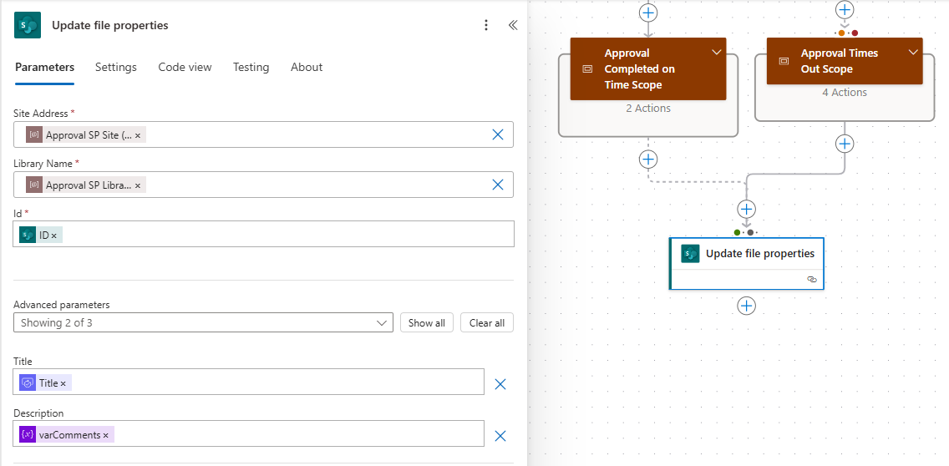
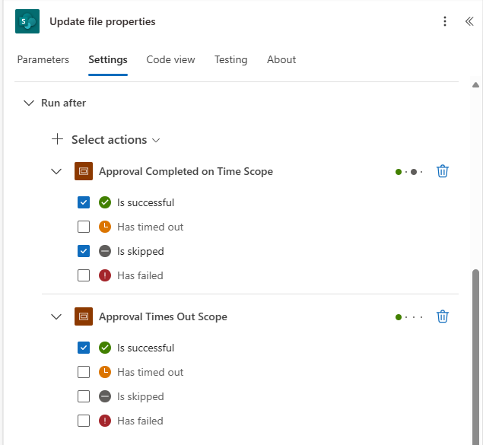

Slide 23
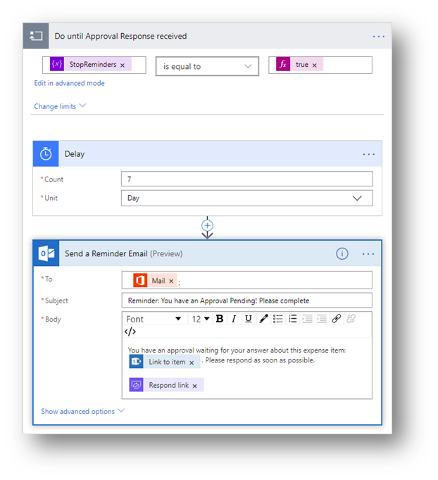
#5 - Periodic Reminders
Problem: Approver may forget to respond
  Need to send periodic reminders
Solution:
  Use parallel branch to send periodic reminders
  Use inner loop delay counter to prevent Approval freeze
  Check Approval Status before sending Reminder
Ongoing Issues:
  How to handle reminders with multiple approvers

Slide 24
Outer Loop runs until Approval is Complete

Slide 25
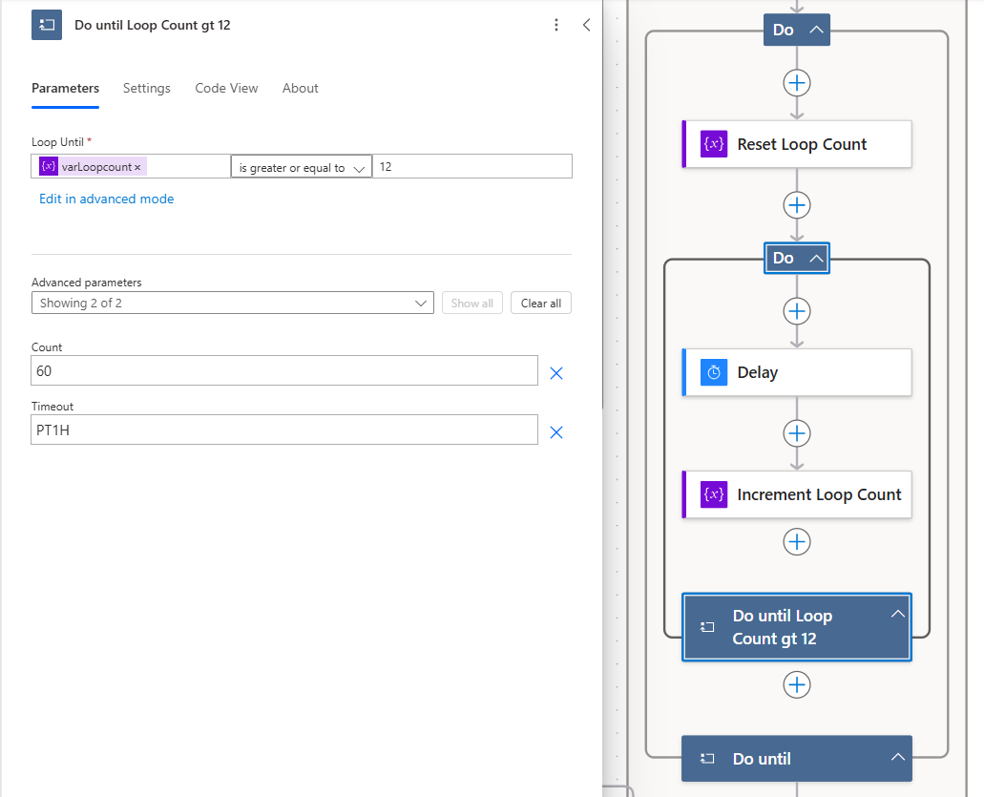
Inner Loop runs until Count or Shorter Time Delays is Finished

Slide 26
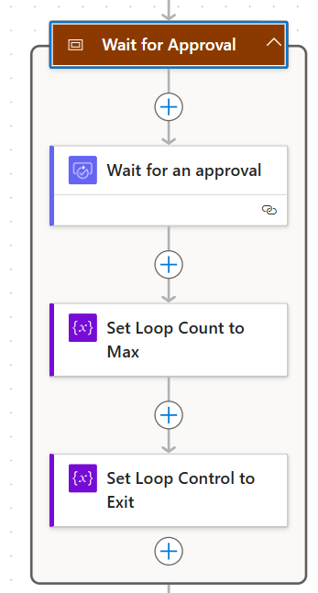
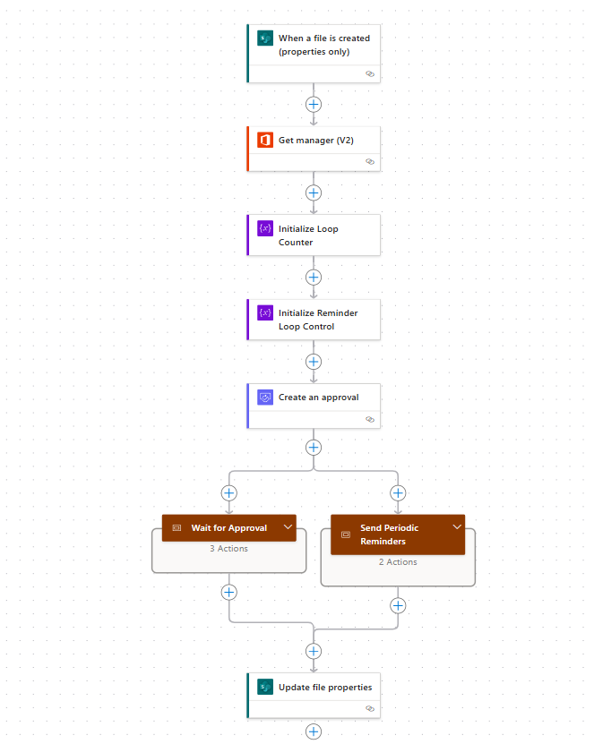
Set Inner Loop to Complete
Set Outer Loop to Complete

Slide 27
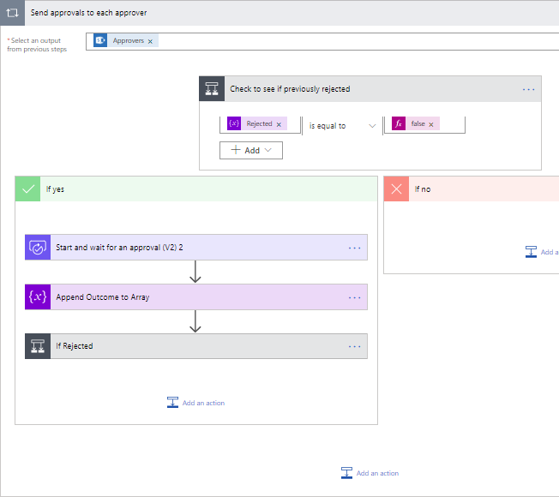
#6 – Serial/Parallel with dynamic approvers
Problem: Number of approvers is changeable
  Need to adjust to a variable set of approvers
Solution:
  Use Apply to each loop to send approvals
  Only send if a previous response didn’t reject

Slide 28
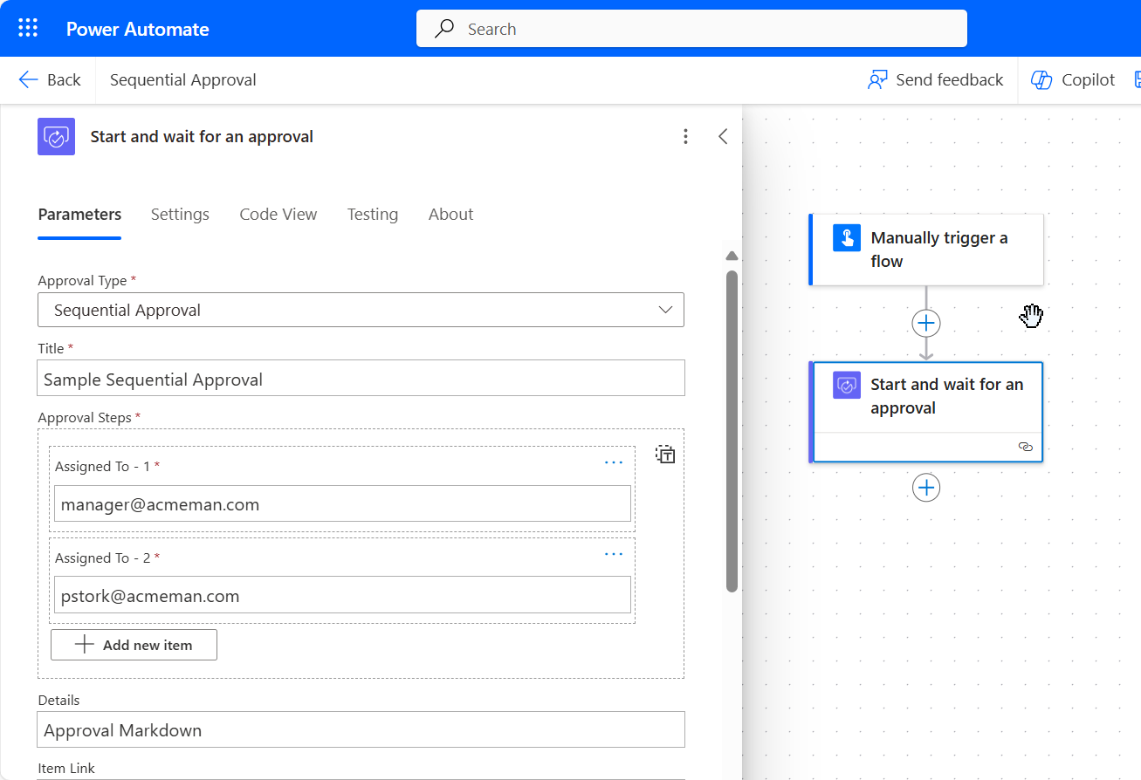
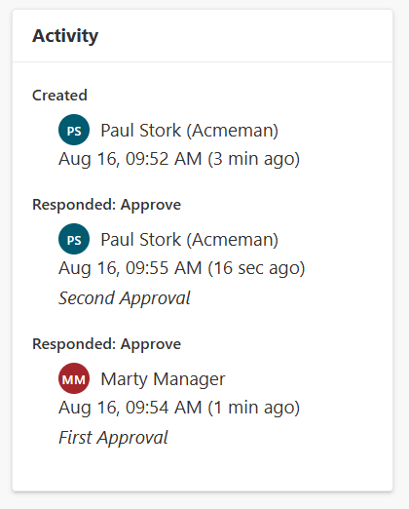

#6a – New Sequential Approvals
Problem: Multiple Serial Approvers
  Need to see Track activity and comments from previous Approvers
Solution:
  New Sequential Approval Type
  Currently in Public Preview
  Enable Get new features early in Environment

Slide 29
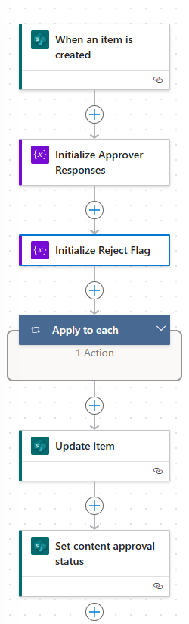
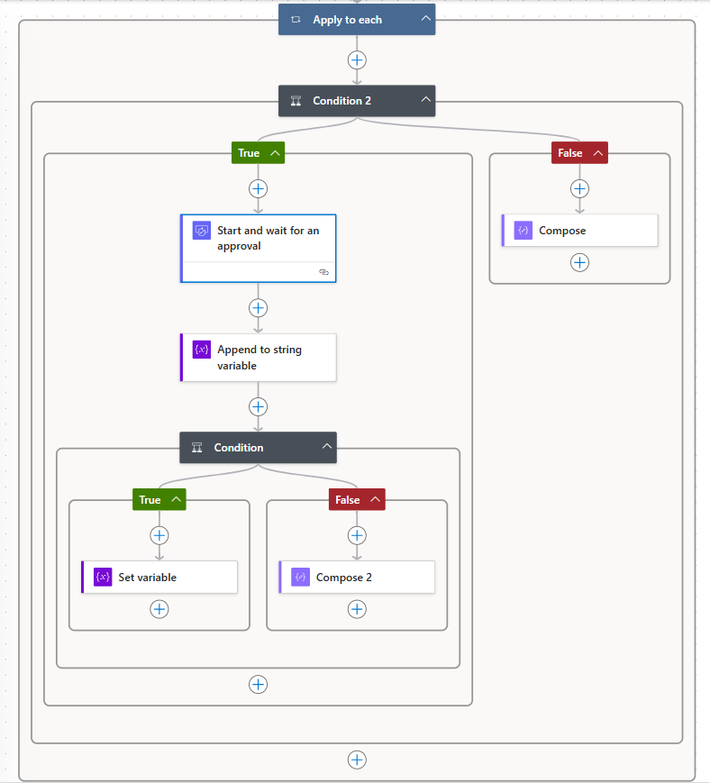
Process Each Email from Approvers
Multiselect Column in SharePoint
If an Approver Rejects Set Variable to True

Slide 30
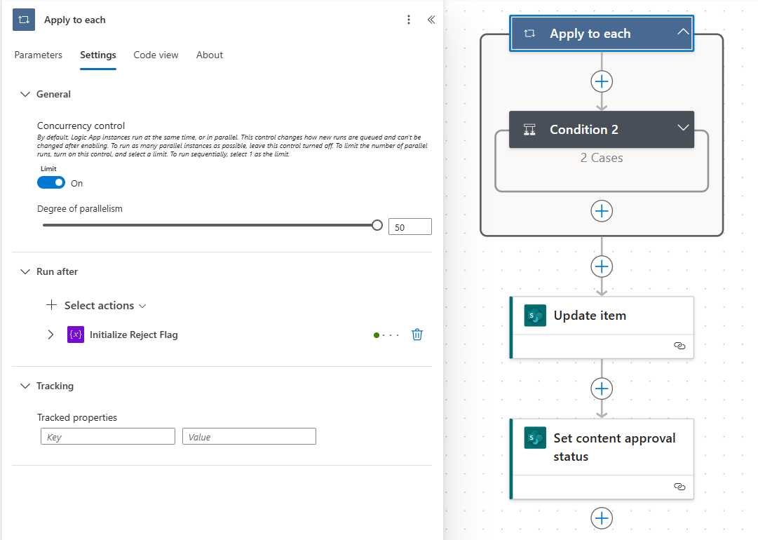
Enable Concurrency to Send Approvals in Parallel

Slide 31
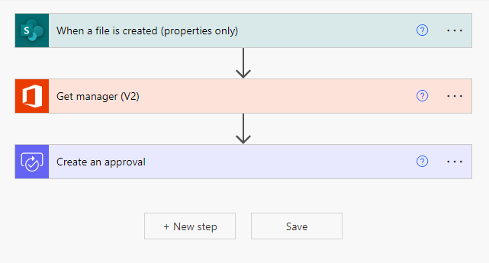
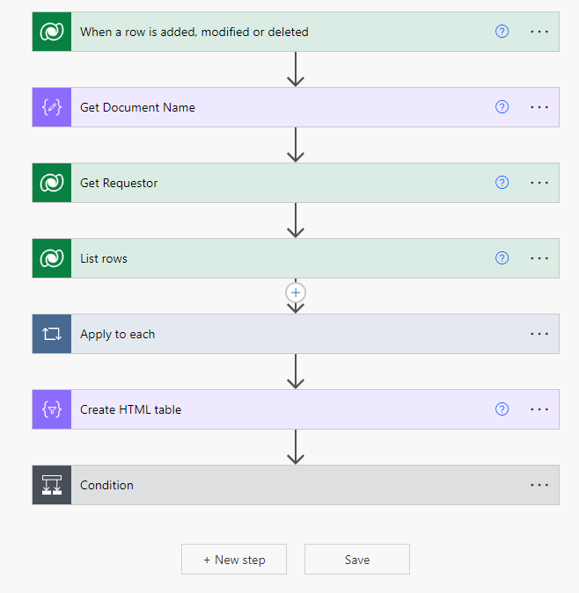
#7 – Long Running Approvals
Problem: 30 day Time Out
  Some Approvals Require more than 30 days to complete
Solution:
  Use One Flow to Create the Approval
  Use a Second Flow to Monitor the Approval for Completion
Start an Approval
Complete the Approval

Slide 32
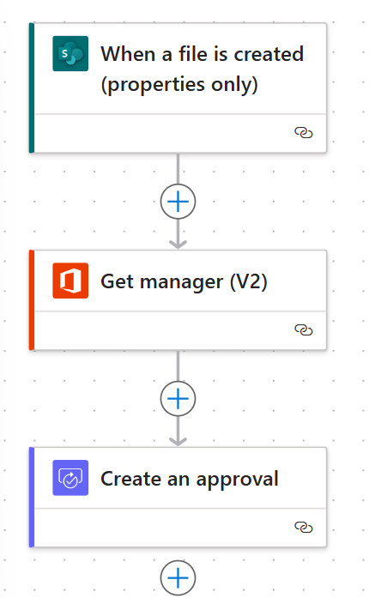
One Flow to Launch and Create Approvals
A Second Flow to Monitor the Responses

Slide 33
last(split(first(split(triggerOutputs()
?['body/msdyn_flow_approval_itemlink’],
'?')),'/'))
triggerOutputs()?['body/_ownerid_value']
msdyn_flow_approvalresponseidx_approvalid eq
'triggerOutputs()?['body/msdyn_flow_approvalid']'

Slide 34
Select Rows to include in a Table with the Results
of the Approval
Convert the new Array to an HTML Table
Check to see if the overall Result was to Approve
or Reject

Slide 35
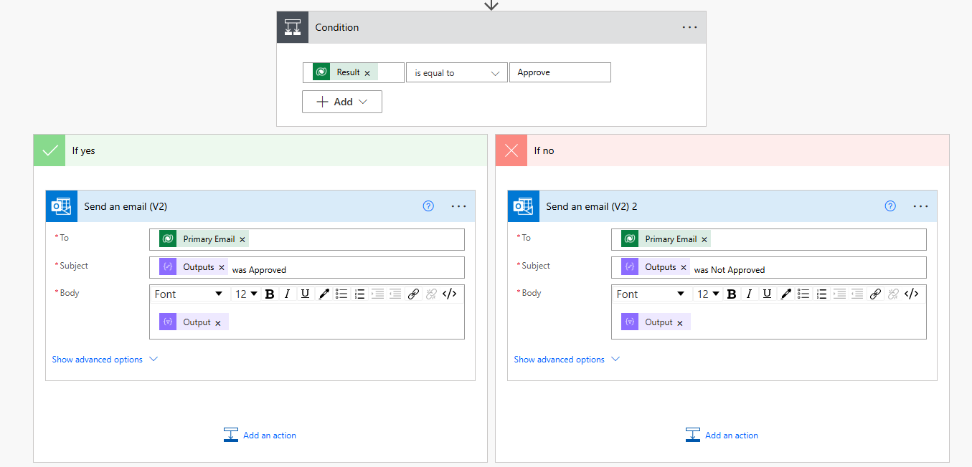
Send an Email with the Results of the Approval
outputs('Get_Document_Name')
body('Create_HTML_table')

Slide 36
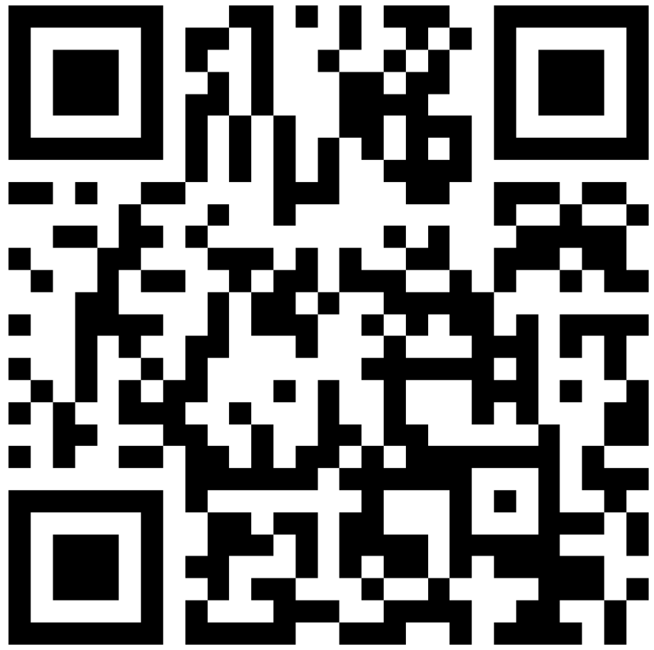

Submit session feedback
Please Submit session feedback

Slide 37


Questions?
Paul Papanek Stork - MCSM, MVP Owner\Principal Architect Email: pstork@dontpapanic.com Cell: 216.272.0573 Web: https://dontpapanic.com Twitter: @PStork

