Slide 1


Beginners Guide to Power BI
Scott Shearer MVP, MCT

Slide 2


Scott Shearer
Microsoft MVP
Microsoft Office Specialist Master
Power BI Data Analyst Associate
Microsoft Certified Trainer
Scott@M365Scott.com

Slide 3



Slide 4








Please thank our sponsors

Slide 5

Submit session feedback

Slide 6
Beginners Guide to Power BI
This session will provide you with the knowledge that you need to quickly become productive using Power BI.
You will be introduced to:
- Power BI licensing
- Power BI Components
- Using the Power BI Desktop app
- Using the Power BI Service
- How to create reports and dashboards
- Learning Resources
Don't have a Power BI license? You can start using Power BI for free!
Attend this demo-rich session and get started with Power BI!

Slide 7
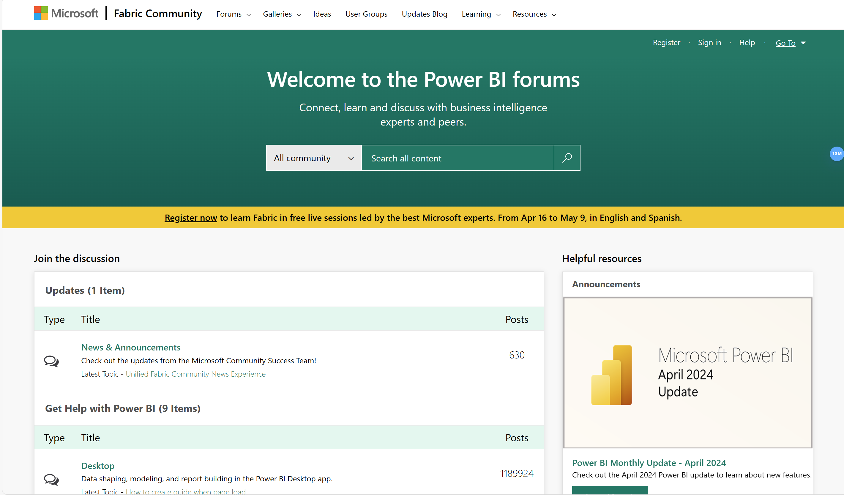
Power BI Community Site
https://community.fabric.microsoft.com

Slide 8
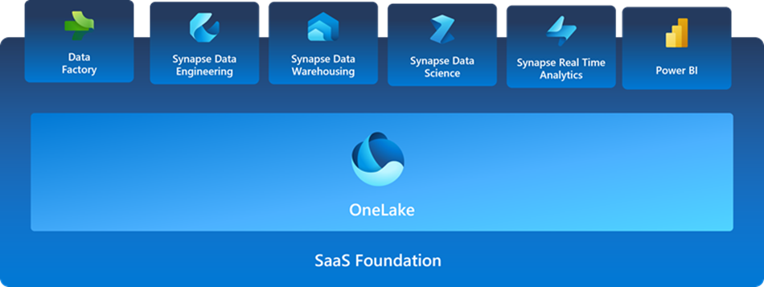
Microsoft Fabric

Slide 9
Microsoft Fabric
Unified Analytics Platform: Microsoft Fabric integrates data movement, processing, ingestion, transformation, and visualization into a single, end-to-end analytics solution.
Centralized Data Management: With OneLake, Fabric offers a unified data lake, simplifying governance, sharing, and access across an organization.

Slide 10
Power BI desktop app
Data visualization tool
Connect to/import disparate data sources
"Clean-up"/Transform data
Create relationships
Create reports using visualizations
Publish reports to the Power BI service
FREE

Slide 11
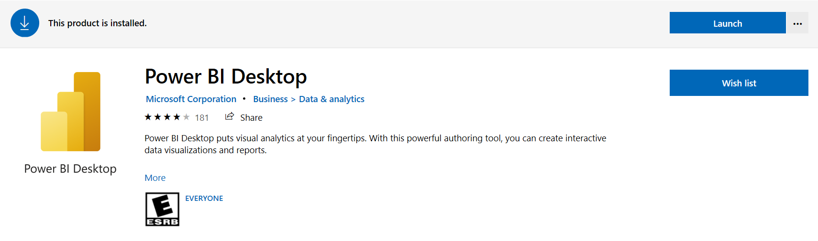
Getting Power BI Desktop
Free!!

Slide 12
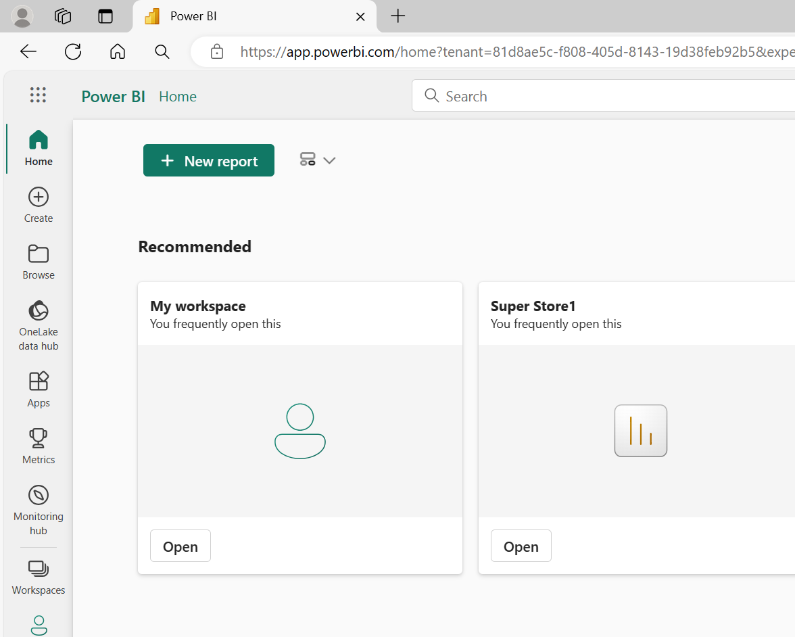
Power BI Service
Share reports
Create and share dashboards
Additional functionality

Slide 13
Power BI process
Get Data
Massage/Transform
Create relationships
Visualizations
Share

Slide 14

Power BI Licensing
It’s complicated…

Slide 15
Viewing Published Power BI Content
IN ALL CIRCUMSTANCES A POWER BI PRO LICENSE IS REQUIRED IN ORDER TO SHARE CONTENT*
To consume content that has been shared, you’ll need either
A Power BI Pro license*
Fabric Capacity (F64)

Slide 16
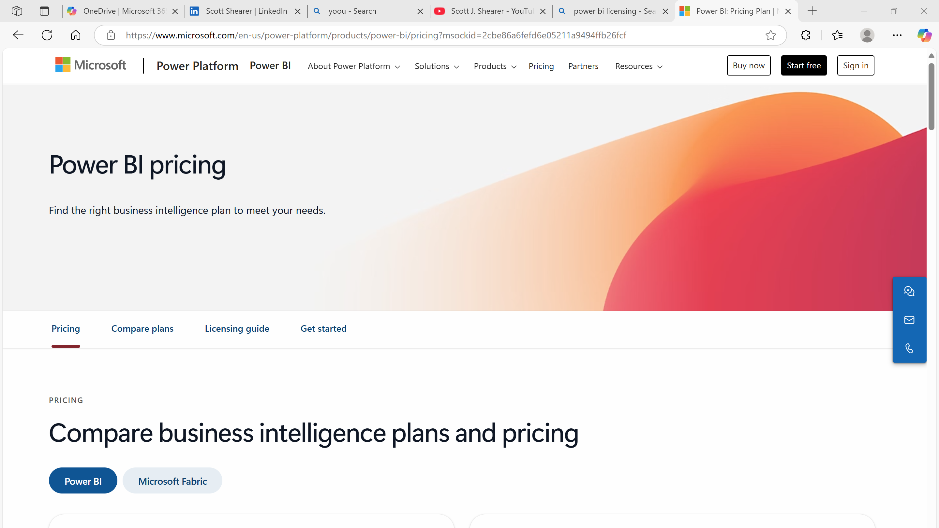
Power BI and Fabric Pricing
Power BI: Pricing Plan | Microsoft Power Platform

Slide 17

Power BI Demonstration

Slide 18
Resources
Guy in a Cube (YouTube)
Power BI Documentation
Power BI Desktop Documentation
DAX Guide
Pragmatic Works (YouTube)
Sqlbi (Marco Russo) (DAX)
Curbal (videos)
Power BI Sample Reports

Slide 19
John White Blog Series – SharePoint and Power BI
https://whitepages.bifocal.show/2018/01 /using-power-bi-to-report-on-multi-value-sharepoint-fields/
https://whitepages.bifocal.show/2018/01 /using-power-bi-to-report-on-person-fields-in-sharepoint/
https://whitepages.bifocal.show/2018/04/using-powerbi-report-managed-metadata-fields-sharepoint/
https://whitepages.bifocal.show/2018/04/power-bi-report-rich-text-sharepoint/
https://whitepages.bifocal.show/2018/04/powerbi-report-hyperlink-picture-fields-sharepoint/
https://whitepages.bifocal.show/2018/04/using-powerbi-report-lookup-fields-sharepoint/

