Slide 1

Introduction to M365 Copilot
Let's enhance our productivity and collaboration

Slide 2
Momentum of conversational AI
By 2026, 30% of work activities involving the use of technology will be conversationally enabled¹
By 2026, conversational artificial intelligence deployments within contact centers will reduce agent labor costs by $80 billion²
By 2026, up to 80% of organizations’ digital experiences will be delivered to consumers
via virtual people²
Source:
1. 2022 Gartner® - Forecast Analysis: Hyperautomation Enablement Software, Worldwide,
2. 2022 Gartner - Forecast Analysis: Hyperautomation Enablement Software, Worldwide
GARTNER is a registered trademark and service mark of Gartner, Inc. and/or its affiliates in the U.S. and internationally and is used herein with permission. All rights reserved.
Notes:
The momentum behind conversational AI is significant, with Gartner forecasting major impacts by 2026. Conversational AI will enable 30% of technology-related work activities, drastically reduce contact center labor costs by $80 billion, and transform digital experiences, with up to 80% delivered via virtual agents. These trends underscore the strategic importance of adopting conversational AI solutions to improve efficiency and customer engagement.

Slide 3
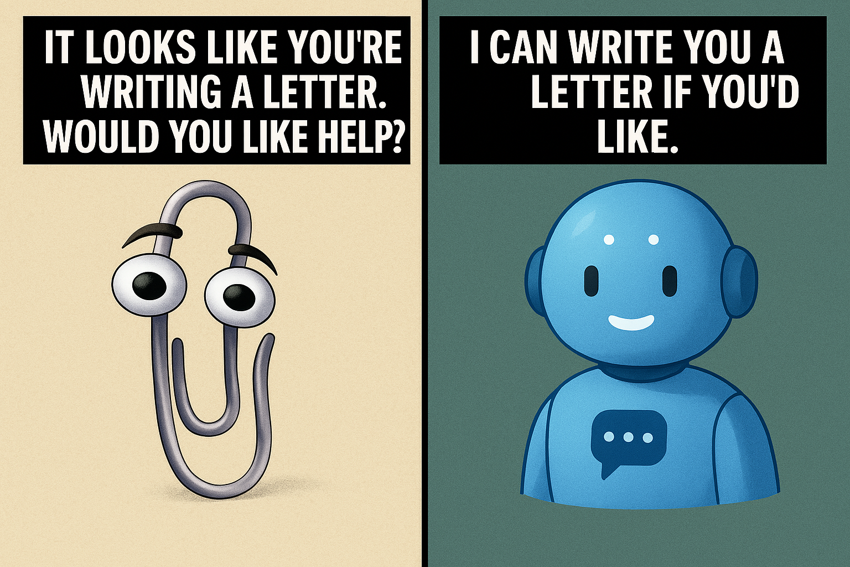

Notes:
Before ChatGPT, There Was... Clippy?"
“Let’s rewind to the late '90s. You’re writing a letter in Microsoft Word, and suddenly—bam!—a paperclip with googly eyes pops up and says:
‘It looks like you're writing a letter. Would you like help?’
Sound familiar? That was Clippy—Microsoft’s overly eager assistant.
Now, fast forward to today. We have AI tools that summarize documents, write emails, and even generate code. But if you think about it… wasn’t Clippy just an early version of generative AI? He tried to understand your intent, offered suggestions, and even had a personality.

Slide 4









Please thank our sponsors

Slide 5

200+ employees
ESOP with HQ in Minneapolis
35 years in business
85% customer retention YOY
Consultant retention >90%
Average tenure: 7+ years
Consultants average 17+ years of experience

Slide 6

Low Code Team Lead at Solution Design Group (SDG)
Power Platform Low Code Developer
Process Automate Expert
Advanced Business Automation
Microsoft SharePoint Architecture
Development and Digital Transformation
M365 Modernization Expert
Ben Stori
Low Code Team Lead / Solution Architect
Notes:
This slide introduces Ben Stori, highlighting his extensive expertise as a Low Code Team Lead and Solution Architect. He leads the Low Code team at SDG and specializes in Power Platform development, process automation, advanced business automation, and Microsoft SharePoint architecture. His role also encompasses digital transformation and modernization within the Microsoft 365 ecosystem, positioning him as a key expert in leveraging low-code solutions to drive business innovation and efficiency.

Slide 7
What we do
Custom Software Development
  Cloud Solutions
  Artificial Intelligence + Machine Learning
  Low-Code Solutions
  Data Engineering
Project Planning + Execution
Experience Strategy + Design
Quality Assurance
DevOps
Product Strategy + Coaching
Strategic Partnerships with Microsoft, AWS, Nintex, Redhat
We produce business and customer focused digital products that drive enduring value.​
Notes:
we are a local consulting company that not only specializes in low code but complete custom software development. Our mission is "to be the best software development company you've ever worked with -- or worked for." We aim to help customers solve challenging business problems using technology while providing an engaging and dynamic work environment, that means we work with you not just for you. We also give back to the community in a variety of ways and presenting at conferences like this one of one of them. We hope to see you at our booth later today.
At SDG, we bring the right mix of expertise, collaboration, and innovation to ensure your success.
We look forward to connecting with you today and exploring how we can work together. Thank you!"

Slide 8
Why use Copilot
Whis is Copilot for M365
Technical Architecture
Versions and Licensing Costs
Microsoft Office Examples
Copilot in Action
Overview

Slide 9
Personal Productivity!

Slide 10
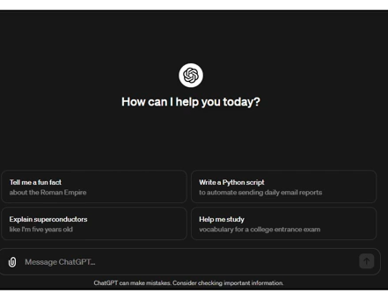
Before Copilot for M365
Copy Email into ChatGPT
Ask ChatGPT for a response to the Email
Provide ChatGPT with some Context
Integrate with ChatGPT
Copy/Paste Back into Outlook

Slide 11
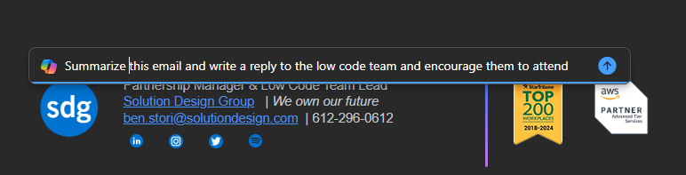
Utilizing Copilot for M365
In Outlook we can draft a reply message and Provide details & additional instructions
Notes:
Shape the future of your business with AI-powered business applications

Slide 12
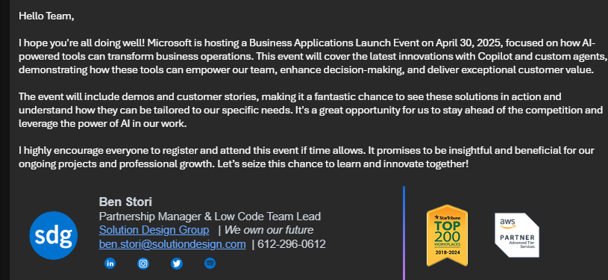
Utilizing Copilot for M365
In Outlook we can draft a reply message and Provide details & additional instructions
Notes:
Shape the future of your business with AI-powered business applications

Slide 13

Overview of Microsoft 365 Copilot
Seamless Integration
  Copilot integrates with Microsoft 365 apps like Word, Excel, and Teams to enhance productivity.
AI-Powered Assistance
  Leverages large language models and Microsoft Graph data for context-aware support and task automation.
Security and Compliance
  Operates within Microsoft 365’s secure environment ensuring enterprise-grade data protection and governance.
Customization Capabilities
  Copilot Studio enables organizations to create tailored AI experiences to meet specific business needs.
Notes:
Why It Matters
Saves Time: Cuts down on routine tasks.
Enhances Creativity: Provides starting points for writing, visuals, or analysis.
Improves Collaboration: Keeps teams aligned with summaries and insights.
Scales Knowledge: Makes data and documents more accessible across the organization.
Think of it as a personal AI assistant inside every Microsoft 365 app, designed to help you focus on higher-value work instead of repetitive tasks.
.

Slide 14
Copilot Pro for M365
A very Powerful Large Language Model (LLM)
Your data in emails, files, meeting, chats, etc. aka Microsoft Graph
Integration with Office (the places you work)
Productivity
Notes:
This is the main version we will be talking about as it’s the most popular. They have a very powerful LLM like chat GPT. The Large Language Model (LLM) in Copilot Pro for M365 significantly enhances productivity by leveraging advanced AI capabilities to assist with various tasks. Here are some ways it contributes to increased productivity:
Data Handling: The LLM can process and analyze vast amounts of data from emails, files, meetings, chats, and other sources, providing insights and recommendations that help you make informed decisions quickly
Integration with Office: By being integrated into Office applications like Word, Excel, PowerPoint, Outlook, and Teams, the LLM can assist with drafting documents, analyzing data, creating presentations, managing emails, and collaboration
Automation: The LLM can automate routine tasks, such as scheduling meetings, creating polls, and generating summaries, freeing up your time to focus on more strategic activities
Enhanced Search and Retrieval: The LLM excels at searching and retrieving information from various sources, making it easier to find and share files or specific pieces of information from conversations or team channels
LLMs can become very powerful, just keep this in mine and always check and read answers to make sure it sounds like a human
The idea is to combine all of these together, into a very powerful productivity machine and integrate an LLM that is aware of all your M365 Data.
It is available to you in all the places you work, which is the idea and make you more productive
Overall, the LLM in Copilot Pro for M365 helps streamline workflows, reduce manual effort, and improve overall efficiency, leading to enhanced productivity

Slide 15

Key Features of Microsoft 365 Copilot
Natural Language Interaction
  Ask Question or give commands in plan English or supported languages
Embedded in M365 Apps
  Word, Excel, PowerPoint, Outlook, Teams, and Business Chat Integration
Contextual Awareness
  Understand your documents, emails, calendar and chats security vis MS Graph.
Data Analysis & Visualization
  Generate formulas, create pivot tables, chats and explain trends in Excel.
  Meeting Intelligence
  Summarize meetings, create task lists and provide catch-up insights in Teams
Notes:
Lets you type requests in plain English (or another supported language).
Example: “Summarize this document in three bullet points” or “Filter sales to only show Q2 Midwest data.”
Copilot understands your emails, calendar, chats, docs, and files (only those you have access to).
This means it can pull in relevant context when helping you draft or analyze.
Instant pivot tables, charts, “explain this trend,” or scenario analysis from natural language.
Auto-summarizes discussions, Creates task lists… Example Provides “catch me up” insights if you join late.
Copilot is not just “chat inside Office apps” — it’s AI that works on your organization’s data securely, in context, and inside the tools you already use daily.

Slide 16
Copilot Versions and Licensing Costs
Version | Cost | Features
Copilot (Free) | $0 | Basic GPT-4 LLM access, image generation, Copilot Chat
Copilot Pro | $20/user/month | Priority GPT-4, 100 image boosts/day, web app integration
Microsoft 365 Copilot | $30/user/month | Full M365 integration, enterprise security, Graph data access
Notes:
Microsoft offers three primary versions of Copilot, each tailored to different user needs and budgets. The free version provides basic access to GPT-4 and GPT-4 Turbo during non-peak hours, along with limited image generation capabilities and access to Copilot Chat. Web grounding which means the LLM is searching the web, for example, you can ask what happened in the NFL free agency yesterday, This free version of Microsoft Copilot no longer has a daily limit on the number of messages you can send. Previously, the limit was capped at 300 chats per day, but this restriction has been lifted. However, there is still a cap of 30 images per day
Copilot Pro, priced at $20 per user per month, includes priority access to GPT-4, enhanced image generation (100 boosts per day) during peak times, and integration with web versions of Word, Excel, OneNote, and Outlook.
Microsoft 365 Copilot, the enterprise-grade offering, costs $30 per user per month and delivers full integration with Microsoft 365 apps, enterprise-grade security, and access to organizational data via Microsoft Graph. You might also hear a term, "Grounded with data from Graph“ which refers to the process of using information from the Microsoft Graph to ensure that responses or actions are based on relevant, specific data and as we know Microsoft Graph is a collection of APIs that provide access to data across various Microsoft services like Outlook, OneDrive, Teams, and more.
For example, if you ask Copilot to summarize your recent emails, it will use data from Outlook via Microsoft Graph to provide a precise summary. This grounding helps in making the AI's output more reliable and tailored to your specific context
Licensing prerequisites include having a qualifying Microsoft 365 plan such as E3, E5, Business Standard, or Business Premium. The Copilot license is an add-on and must be managed through the Microsoft Admin Center.

Slide 17
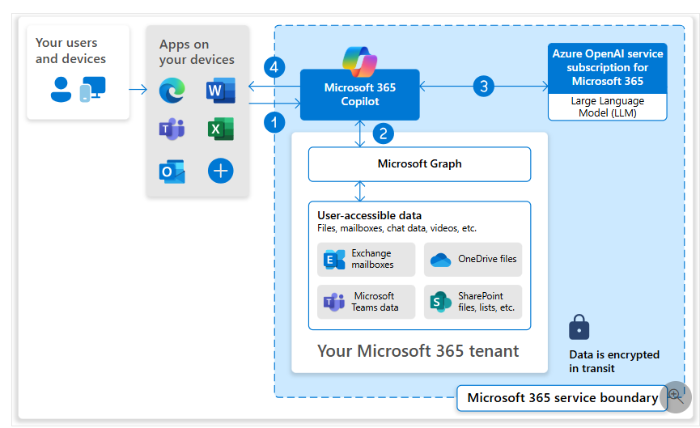
Copilot Architecture

Slide 18

What Can you do with Copilot for Word
Drafting Documents
  Use Copilot to generate initial document drafts based on a brief description or outline we provide
Summarize Content
  Summarize long files to get key points
  Save time on document reviews
Writing Assistance
  Enhance your writing with grammar, style and tone improvements
Research Aid
  Find and integrate relevant information or data from the web or the organizations repository directly into a file
Language Translation
Notes:
Copilot exists in Word…we can draft maternal and documents, you can have it open up a document that has already been created and ask Copilot to summarize it, get writing asssitace on it, for example if you highlight a paragraph you can have it updated based on a certain tone or style
.

Slide 19

What Can you do with Copilot for Excel
Data Analysis
  Analyze complex datasets
  Provide summaries, trends, insights
Creating Charts
  Generate charts & graphs from selected data with simple commands
  Enhance the data visualization
Formula Crafting
  Write complex formulas based on a description
  Save time & reduce errors
Data Cleaning
  Automate the process of cleaning data such as duplicates or formatting issues
Predictive Modeling
  Build predictive models and forecasts directly within Excel based on historical data
This Photo by Unknown Author is licensed under CC BY-SA
Notes:
Make sure everything is formatted as a table. Copilot only works with Tables in Excel.
This needs to be saved in OneDrive or SharePoint with Auto SAVE Turned on associated with the account.
If you do these steps and copilot is grayed out, you might need to update your license.
You also need to know, that it currently doesn’t work with rows. Just columns.

Slide 20

What Can you do with Copilot for PowerPoint
Create Slides
  Generate presentation slides from a text outline or summery you provide
Design Suggestions
  Leverage Copilot to suggest and apply design themes, animations & transitions to enhance the visual appeal
Content Summarization
  Quickly summarize detailed content into concise bullet points
  Information is easier to digest
Data Visualization
  Create charts, graphs, and other visual data representation from raw data
Practice and Feedback
  Rehearse your presentation and get feedback on pacing, tone and clarity to improve your delivery

Slide 21

What Can you do with Copilot for Outlook
Email Drafting
  Compose emails quickly by providing a brief description of the intent of the message
Summarizing Emails
  Summarize long email threads to understand the conversation
Scheduling Assistance
  Help manage your calendar, suggest available times for meetings based on your schedule
Email Prioritization
  Prioritize incoming emails, ensuring important messages are addressed 1st
Quick Responses
  Generate concise, professional responses to common inquiries with Copilot, saves time on email communication

Slide 22

What Can you do with Copilot for Teams
Meeting Summaries
  Automatically generate concise summaries of Teams Meetings
  Capture key decisions and action items
Meeting Help
  Ask questions during the meetings and how to improve the meetings
Collaborative Editing
  Co-author documents directly in Teams with Copilot suggesting improvements
Task Automation
  Automate routine tasks, like scheduling meetings or creating polls within Teams Channels
Information Retrieval
  Quickly find and share files, or specific pieces of information from conversations or team channels

Slide 23
Building Good Prompts
Dos
To have a more successful copilot experience, do the following:
Be clear and specific.
Keep it conversational.
Give examples.
Check for accuracy.
Provide contextual details.
Be polite.
Don'ts
If you want to have a more successful copilot experience, don't:
Be vague.
Give conflicting instructions.
Request inappropriate or unethical tasks or information.
Interrupt or quickly change topics.
Use slang or jargon.
Notes:
Being clear and specific can help you avoid undoing changes that the system made to the wrong items. For example, if you enter a prompt to "Change the button to blue," and you have multiple buttons, Copilot must choose which button without guidance. Instead, if you enter the prompt as "Change Button_1_2 to be blue," your request is more specific on which button to change. In this example, you could be more precise on what you want. Buttons have multiple color options that Copilot can change, and in the previous prompt, Copilot still must choose the color. To be more precise, you could include that you want to change the text color. For example, you could enter the prompt as "Change Button_1_2 text color to be blue".

Slide 24
Let’s See Copilot in Action!

Slide 25
Copilot Online In Action
summarize all my M365 Twin Cities - Fall 2025 emails
Recap SDG Presents! Avoid the Data Dumpster Fire: Practical Planning for Power Platform Builders summarizing key takeaways and action items as separate sections, including who's responsible for each.
Notes:
Ex 3: change the tone of the text
Auto updated text
Update to casual
Ex 4: transform Text into a Table

Slide 26
Word Examples
Ex 1: Write a job description for an account associate position. Minimum 5-year experience. Remote job. Experience with QuickBooks Cloud is a requirement.
  In the how to Apply Section, candidates should apply online at resume@solutiondesign.com
Ex 2: Create a proposal that make a case to expand Primetimes coffee product to Europe.
  Product Details:
    Coffee is completely made from free-trade and ethical farming sources
    It has the best test
    Outline
  Executive Summary
    Quick Overview of the expansion plan, highlighting the potential for growth and the unique aspects of the coffee product.
  Market Analysis
    Insight into the European Coffee Market Trends, consumer preferences and identification of key target markets
  Product Offering
    Description of the coffee products tailored for the European market, emphasizing unique features
  Marketing and Sales Strategy
    Outline approach to building awareness and sales channels, including digital marketing and retail partnerships
Notes:
Ex 3: change the tone of the text
Auto updated text
Update to casual
Ex 4: transform Text into a Table

Slide 27
Excel Examples
General Data Analysis
  OOTB Insights
  Add all insights to grid
  Show me insights about the number of Customers Column
  Are there any trends in my data, or any outliers in my data
Data Q&A (most used feature)
  What is the total sales in the year 2020?
  What is the average Latte sales for each store in 2019?
Data Filtering
  Filter to where year = 2018
  More personalized example ( filter to only store A or show me only Store B)
  Filter to Latte and 2018
Data Formatting
  Highlight the rating column in red where rating is below 3.0 (can only do this on a column)
  Bold the rows where the rating is higher than 4.5
Data Manipulation
  Add a new profit column
  Add a column called profit percentage that is calculated as profit divided by sales
  Add a column called “Rating Band” that is calculated as “Good” is rating is above 4 and “Bad: if its below 4
  Add in a new column called “Store Letter” that is a calculated as the store letter from the store column
  Add a new column called “Spike Ratio” that is calculated from the Profit divided by customers
Charts and Graphs
  Use the word chart or graph in your prompt
  Create a bar char showing the total sales by store
  Create a bar chart showing the total sales by store in 2019 only
Notes:
Its great to ask questions, which can be a lot of back and forth between people. The best way to ask a question is to be as detailed and specific as possible. Be as detailed as possible and reference the column names when writing your questions
We don’t need exact instructions to filter, we can just talk to Copilot like a data analysis

Slide 28
PowerPoint Examples
Create Presentations
  Create a presentation about why coffee is the best thing to drink in the morning
  Create a presentation about why coffee is the best thing to drink in the morning, focus on health benefits
  Rewrite this slide to sound more executive-friendly.
Create a Presentation from a Template
  Open a template
  Create a presentation about why dogs are better than cats
Convert Word into PowerPoint
  Create a presentation from file Coffe_Details.docx
Summarize and organize presentations
Notes:
Open a blank PowerPoint Deck
- It creating an entire story for you, not just text and bullet points
Gives you speaker notes as well
The more prompts you give it the better it will be

Slide 29
Outlook Examples
Draft Emails
  Tell my team that our proposal for Primetime Coffee is expanding to Europe and approval are completed. Next Steps include drafting the marketing strategy and getting some lawyers involved. We need to research the best locations, target markets, and competitors in Europe, as well as the legal and regulatory aspects of operating there. I will assign you to different teams and tasks soon, so please stay tuned for more details.
  I am confident that we can make this expansion a success and bring Primetime Coffee to a new level. Thank you for your dedication and enthusiasm. Please let me know if you have any questions.
Summarize email threads
Reply to emails

Slide 30
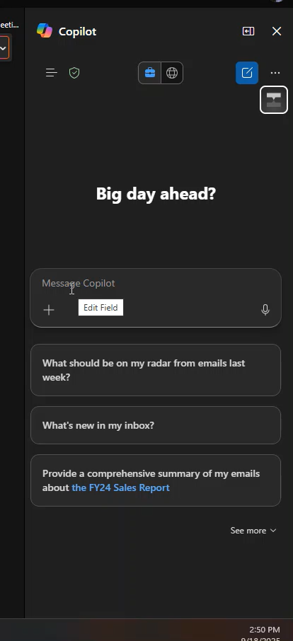

Slide 31
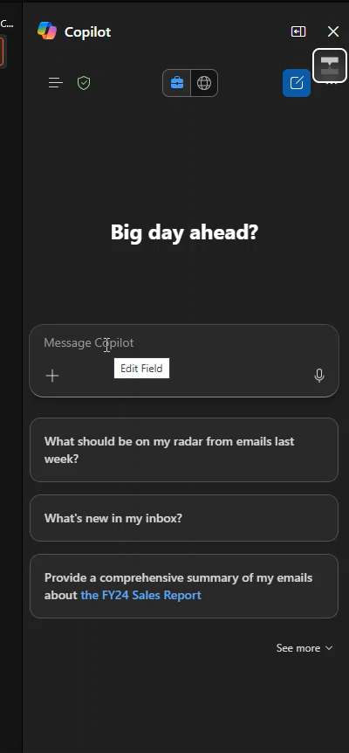

Slide 32
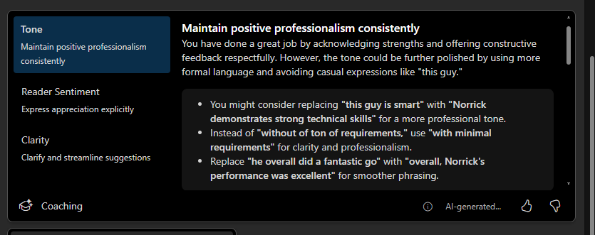
Message Context Help

Slide 33
Teams Examples
Summarize and Ask Questions during Meeting
Catchup During meetings with Teams
  Prompt: Recap the meeting so far
  Prompt: Was the topic of X discussed? Does Kyle like the plan?
Ask Questions during Meetings
  What is Ben's take on Copilot for M365?
Meeting Coach
  What is Ben's argument for using Low Code?
  What are some holes in Kyle's argument?

Slide 34
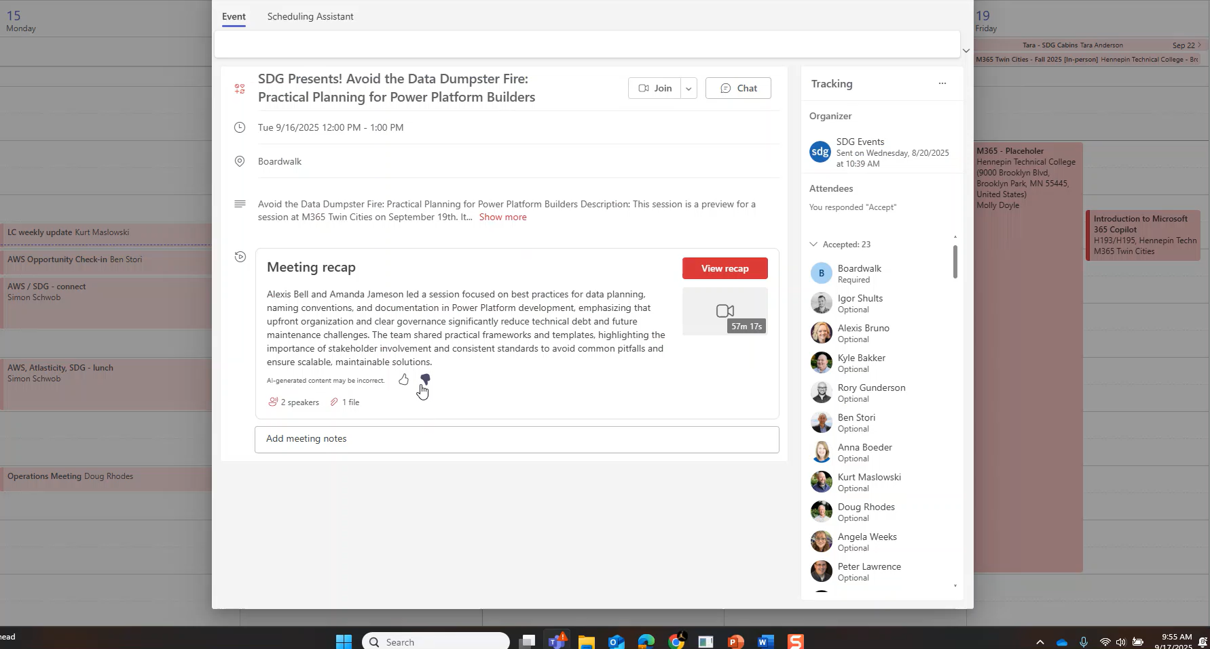
Team Meeting Examples

Slide 35
Business Value & ROI
Time savings: up to 40% faster drafting/summarizing (Microsoft studies)
Employee productivity: democratizes advanced Excel/PowerPoint features
Strategic value: faster decision-making, better knowledge sharing
Example ROI: One hour/week saved = 50 hours/year per employee
Notes:
Copilot delivers measurable business impact. Studies show up to 40% faster drafting and summarizing. Employees who aren’t experts in Excel or PowerPoint can suddenly do advanced tasks, leading to faster decision-making and better collaboration.

Slide 36
Adoption & Change Management
Approach: Pilot → Champions → Scale
Key success factors:
  Training users to write effective prompts
  Setting Copilot etiquette (not replacing critical thinking)
  Measuring outcomes (time saved, employee satisfaction)
Notes:
Adoption requires a thoughtful approach: start with a pilot, build a champions program, then scale across the organization. Training users on effective prompting, setting etiquette, and measuring outcomes are all key to success.

Slide 37
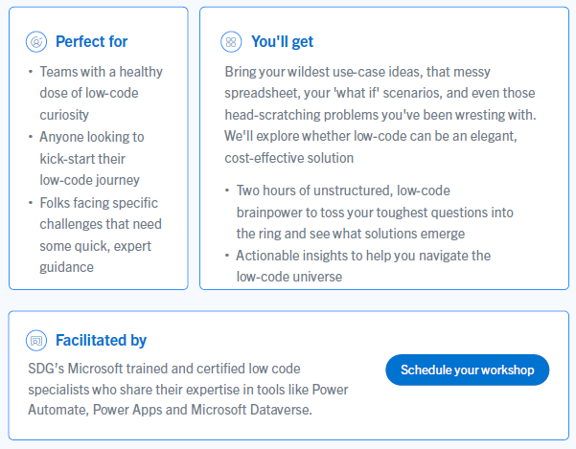

SDG Low Code Solutions
2 Hour
Workshop
Could Low Code be the right solution for your business?

Slide 38

Submit session feedback

Slide 39

Q&A and Thank You
For questions and follow up
Ben Stori
Low Code Team Lead
ben.stori@solutiondesign.com
See our website for more information
www.solutiondesign.com

